Slide 1


Slide 2

Introduction to Data Analyst and Data Science for Beginners Lecture # 3 Operators and String Data Structure in Python
Ehtisham Sadiq

Slide 3

Today’s Agenda
Recap of Previous Lecture
Assignment Solution
Quiz’s Solution
Comments in Python
Operators in Python
Arithmetic Operators
Assignment Operators
Comparison Operators
Logical Operators
Bitwise Operators
Identity Operators
Membership Operators
What is Data Structure (Data Types) and String Data Structure
Defining Strings in the Python
Accessing characters of a String (Indexing)
Strings are immutable(Reassigning String)
Strings Slicing
String Concatenation
String Deletion

Slide 4

Assignment’s Solution
Demonstration
Assignment_Solution.ipynb

Slide 5

Quiz’s Solution
Demonstration
Quiz_Solution.ipynb

Slide 6
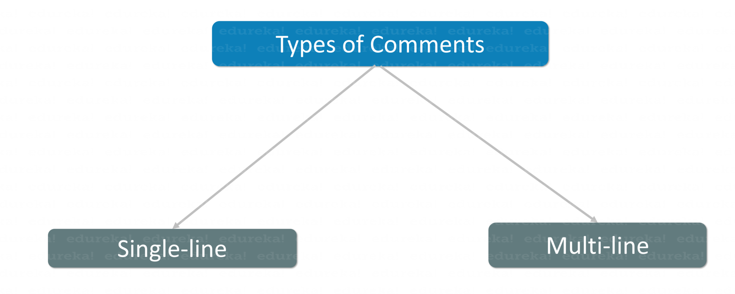
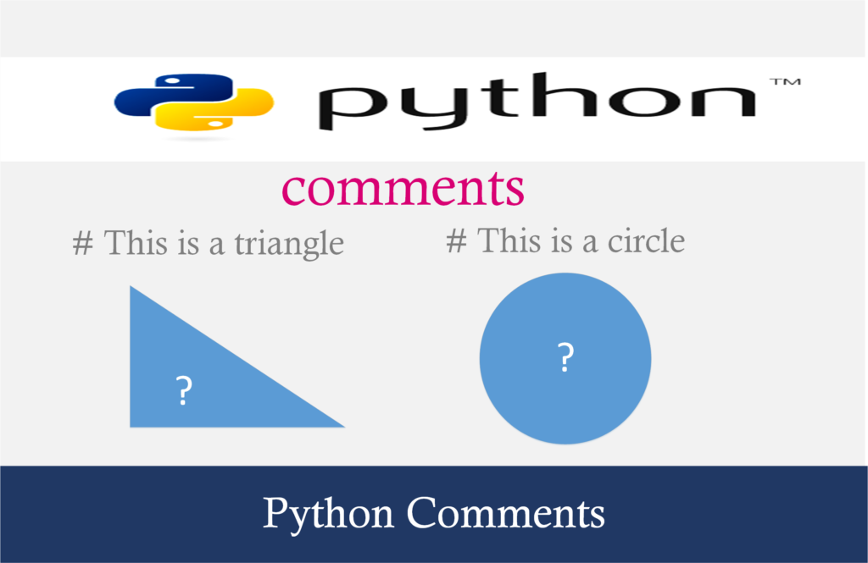
Comments in Python

Slide 7
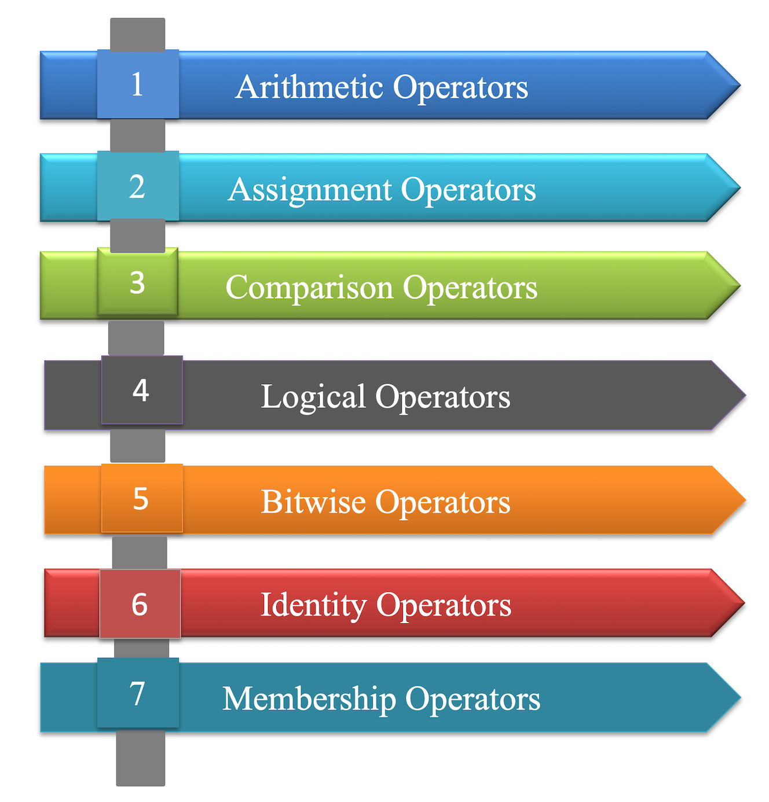
Operators in Python

Slide 8

Any Question?

